Slide 1
HAN 2024 European Electronics market Dirk Stans
Notes:
View on the European electronics manufacturing market

Slide 2
Who are we?
Prototypes & Small Series, produced & assembled in house in Europe
Almost 100% of our sales = online
2023 figures:
+ 550 Eurocircuits colleagues
+ 11.000 professional customers (20.000 users) in Europe
+ 100.000 orders
+ 49 M€ consolidated sales
Started 1991, is Belgian and is privately owned
Factories in Hungary and Germany & Engineering in India
Local sales in Belgium (HQ), France, Germany, UK, Switzerland, Italy, Spain and Hungary
Notes:
We are your single-source PCB and assembly partner for prototypes & small series made in house in Europe

Slide 3
Printed Circuit Board manufacturing
Eurocircuits pooling production panel

Slide 4
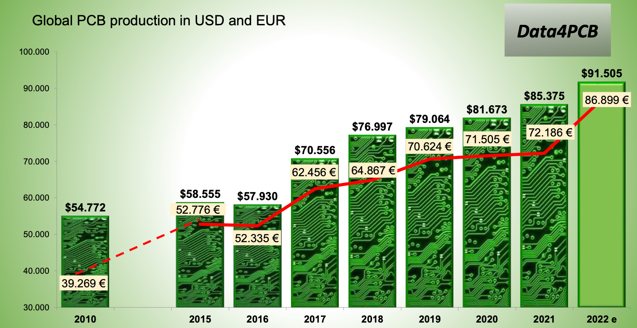
Copyright Data4PCB

Slide 5
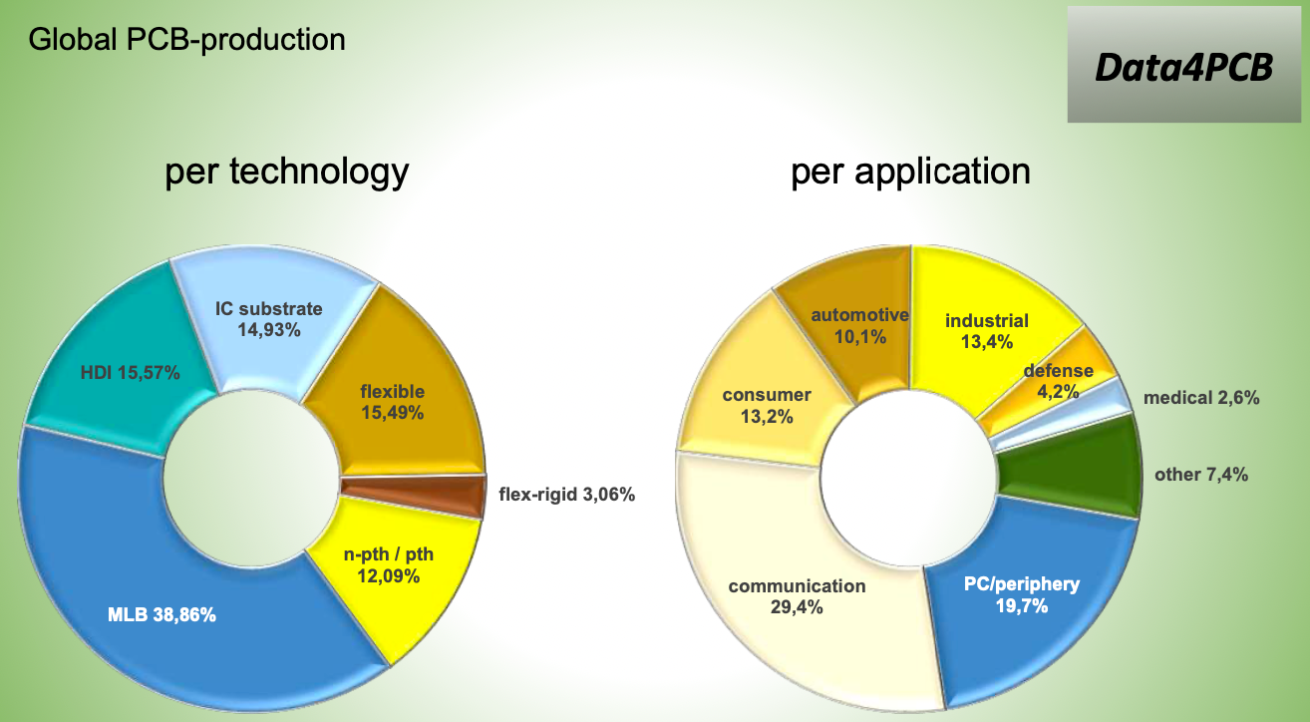
Copyright Data4PCB

Slide 6
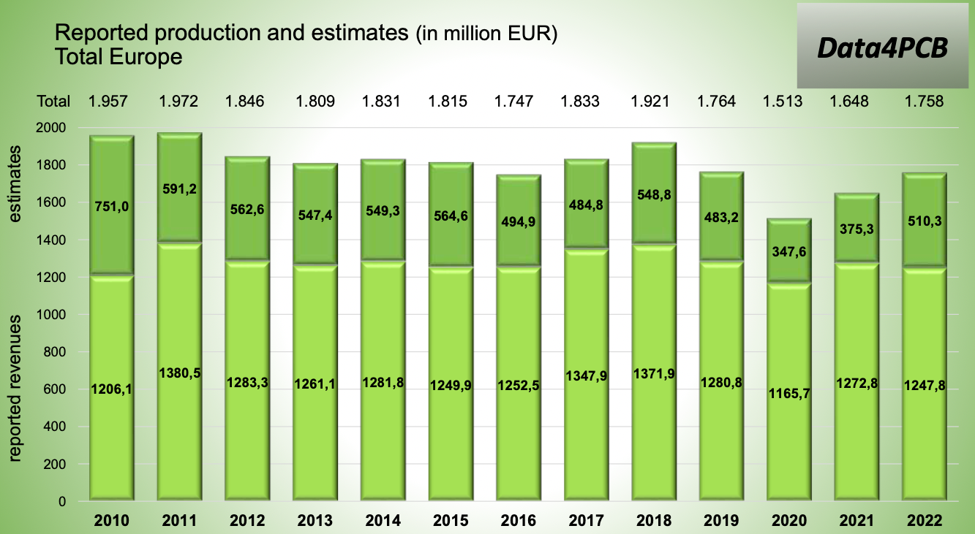
Copyright Data4PCB

Slide 7
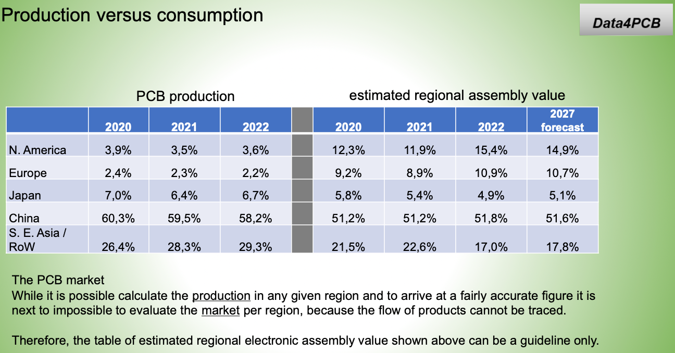
Copyright Data4PCB
Notes:
Europe in 2000 had a global PCB market share of 13,8%

Slide 8
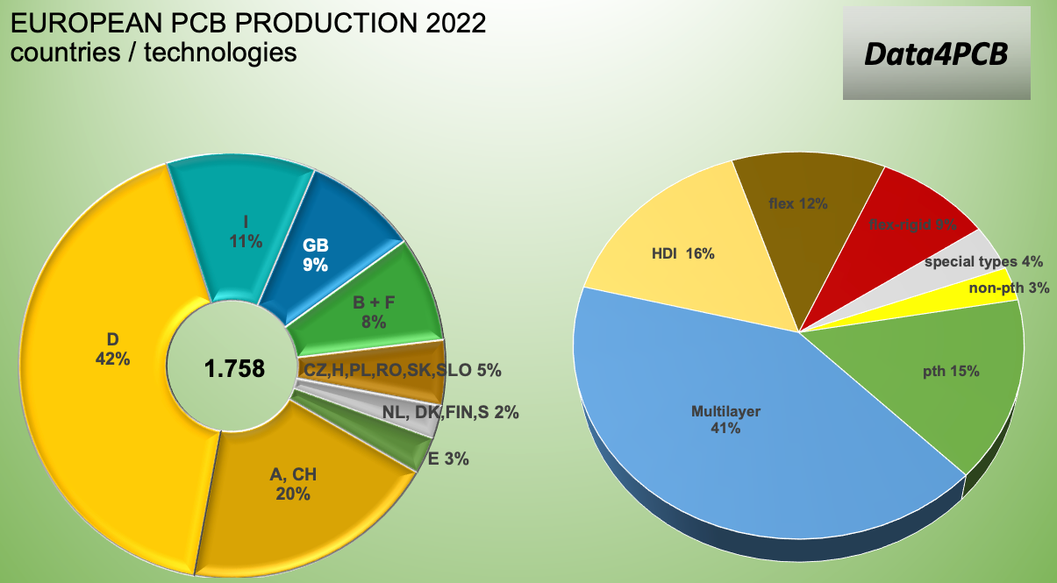
Copyright Data4PCB

Slide 9
Copyright Data4PCB

Slide 10
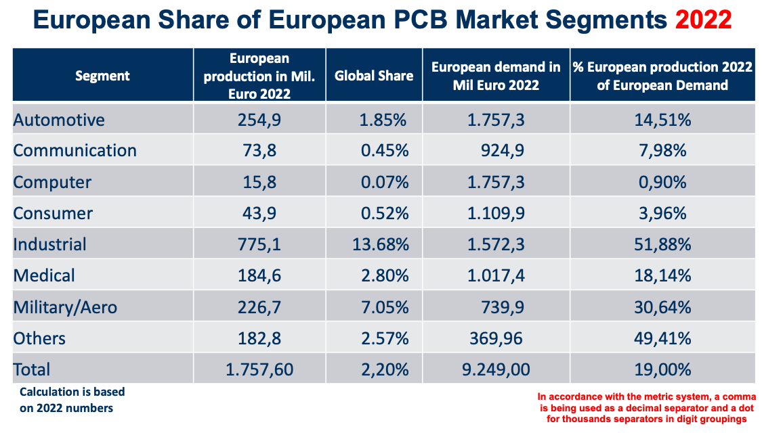
Copyright Weiss Engineering

Slide 11
Copyright Data4PCB

Slide 12
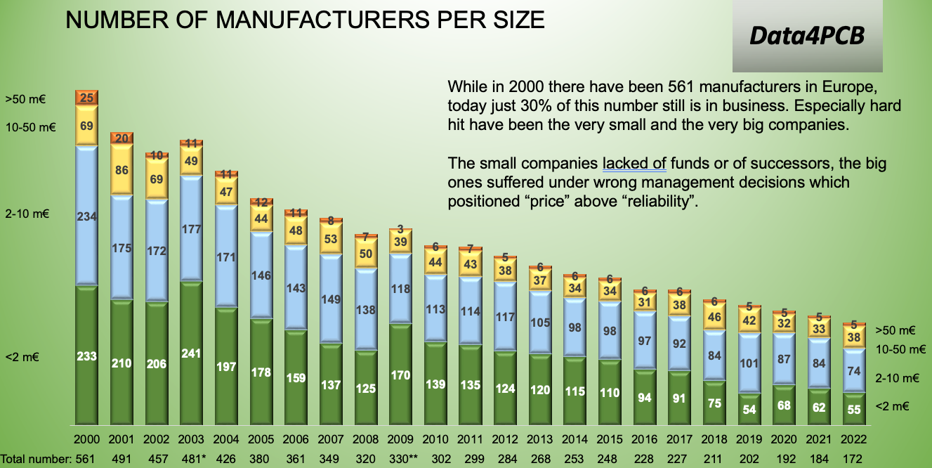
Copyright Data4PCB

Slide 13
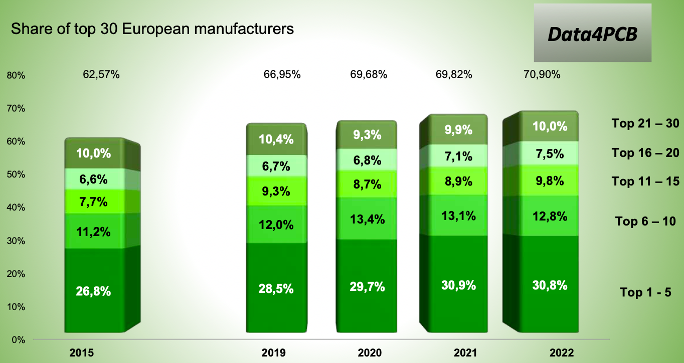
Copyright Data4PCB

Slide 14
Copyright Data4PCB

Slide 15
Printed Circuit Board Assembly
Eurocircuits equipment PCBs

Slide 16
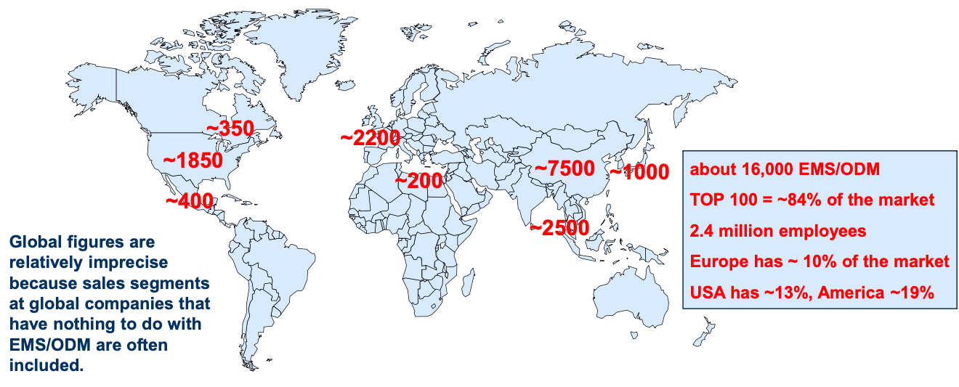
Global EMS/ODM market 2023
Copyright Weiss Engineering

Slide 17
Copyright Weiss Engineering
Notes:
By comparison, NL's GDP is +/-1000 B€. So the total European electronics market is +/- 15% of NL's GDP or 25% of Belgium’s +/-600 B€ BBP.

Slide 18
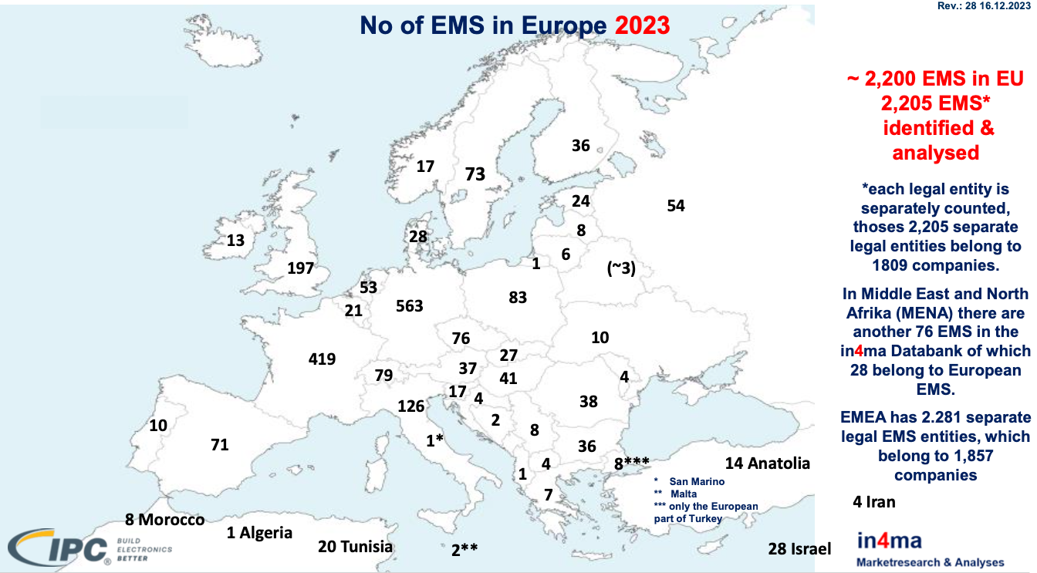
Copyright Weiss Engineering

Slide 19
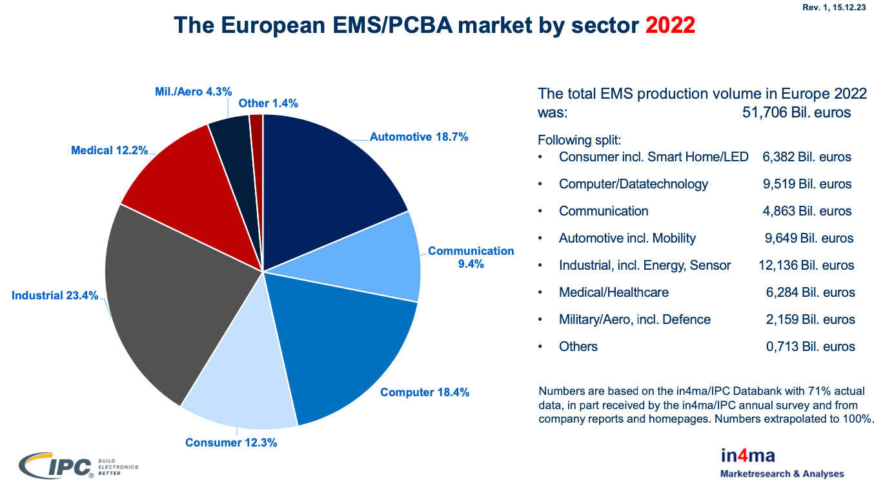
Copyright Weiss Engineering

Slide 20
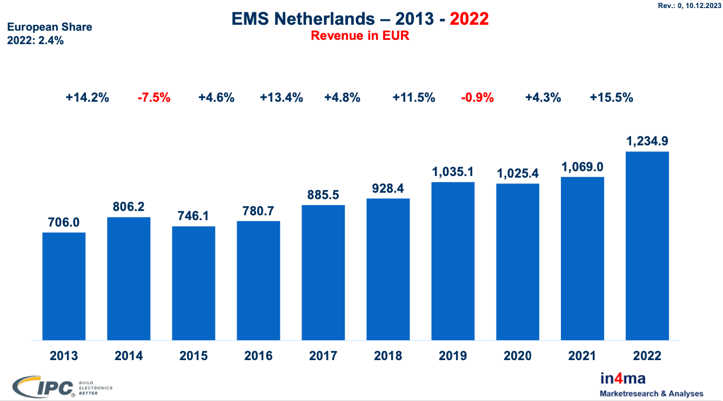
Copyright Weiss Engineering

Slide 21
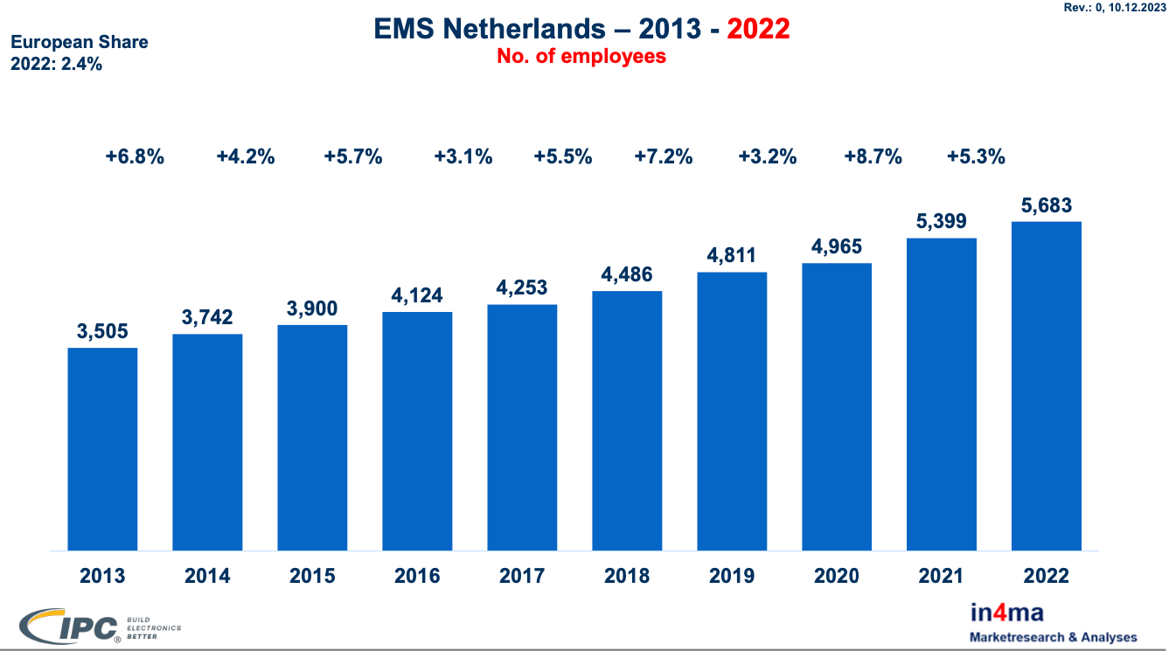
Copyright Weiss Engineering

Slide 22
Copyright Weiss Engineering

Slide 23
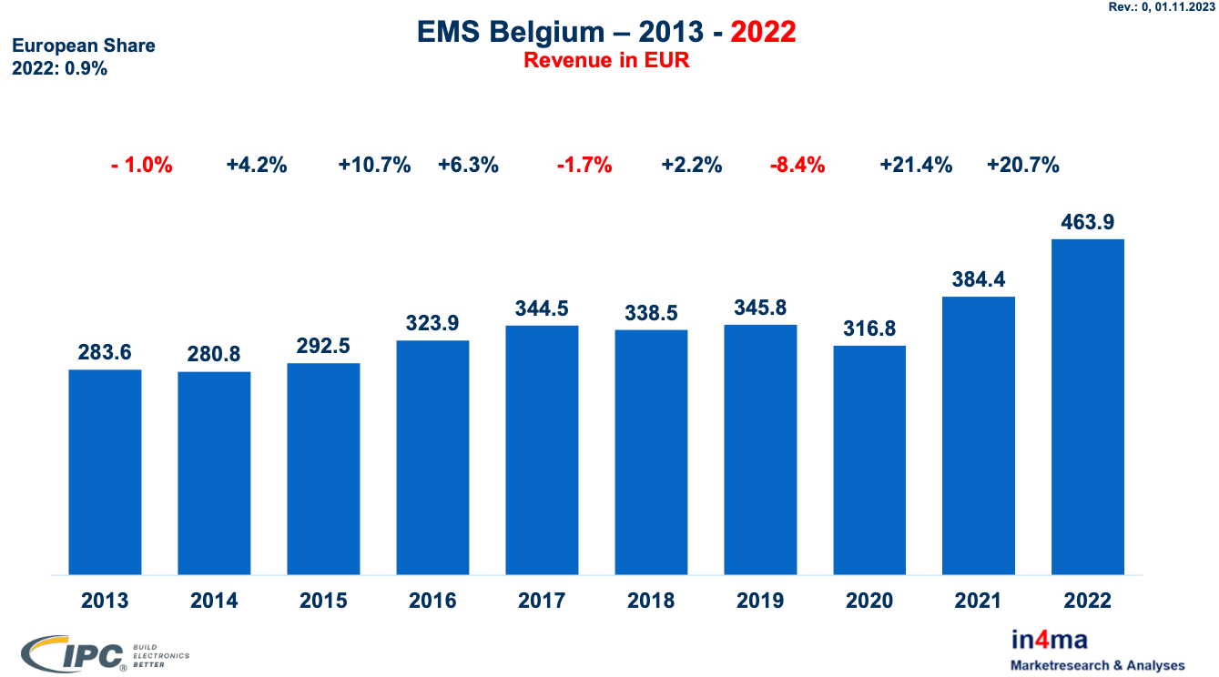
Copyright Weiss Engineering

Slide 24
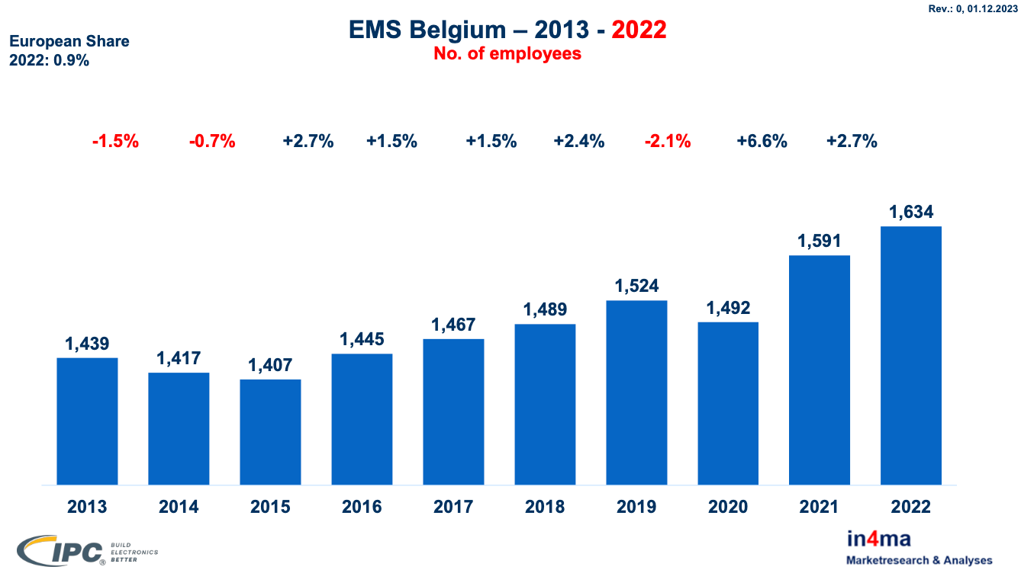
Copyright Weiss Engineering

Slide 25
Copyright Weiss Engineering

Slide 26
Copyright Weiss Engineering

Slide 27
European Chip Act
Silicon manufacturing

Slide 28
EU Chip Act objectives
strengthen EU research and technology leadership
build and reinforce EU capacity to innovate in the design, manufacturing and packaging of advanced, energy-efficient and secure chips, and turn them into manufactured products
put in place an adequate framework to increase substantially EU production capacity by 2030
address the acute skills shortage, attract new talent and support the emergence of a skilled workforce
develop an-in-depth understanding of global semiconductor supply chains and take appropriate measures when necessary
Source = European Commission

Slide 30
EU Chip Act objectives
Go from +/-10% of worlds the CHIP manufacturing volume to +/-20% by the year 2030.
But during the time from of the Chip Act the market will grow in average 6-7% a year and that over a period of 10 years make and increas of 79-97% market growth
=> in absolute value the 10% growth in market share will be much more than doubling the capacity
And a Chip cannot function on its own as it needs the complete electronics value chain to function

Slide 31
Electronics Value Chain
Steps
Available in the EU
Chip development of hardware and software
Chip production
Chip packaging
Chiplet production and packaging
PCB production
PCBA production
Box build
Service / Repair / Refurbishing
Some but inadequate
+/-10%
Hardly
Some embryonic investments
19% of what we need
Same as chips but build for industrial application chips
OK for Box and rest

Slide 32
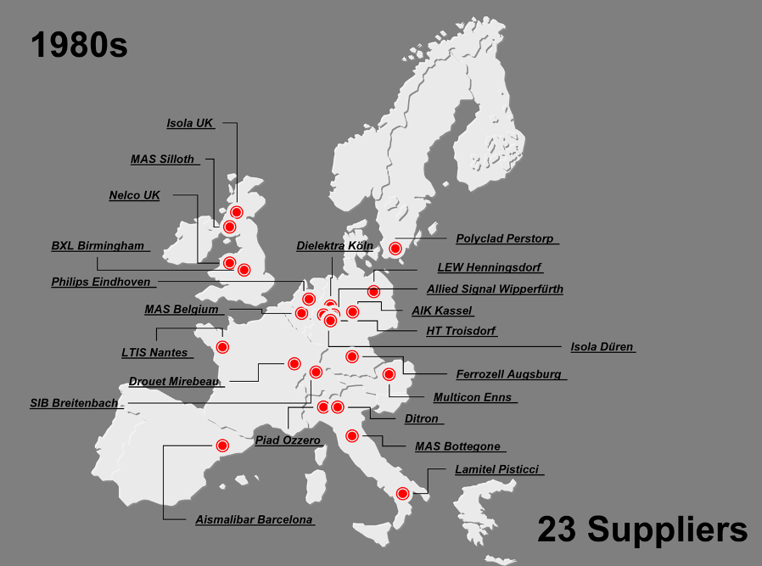
PCB base material suppliers in EU

Slide 33
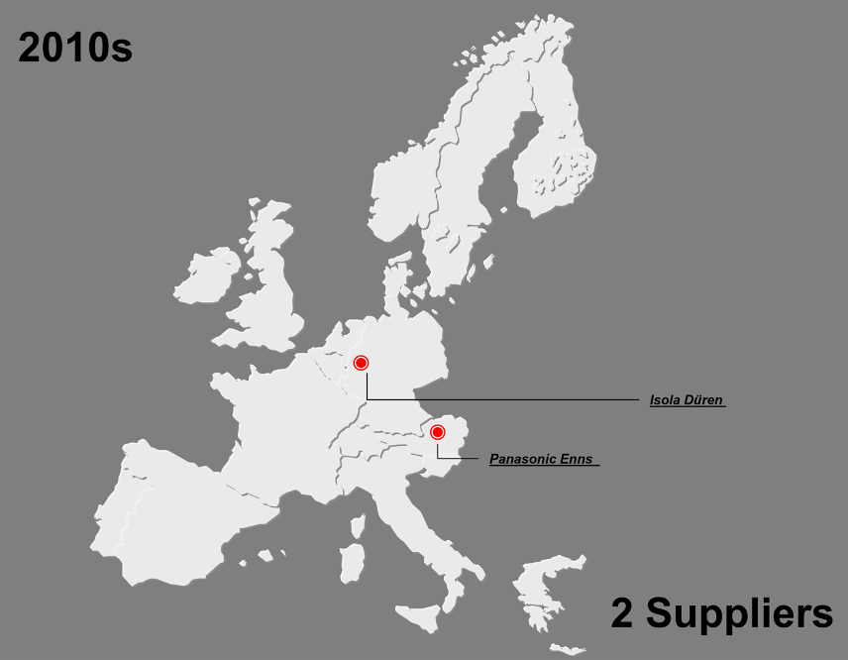
PCB base material suppliers in EU

Slide 34
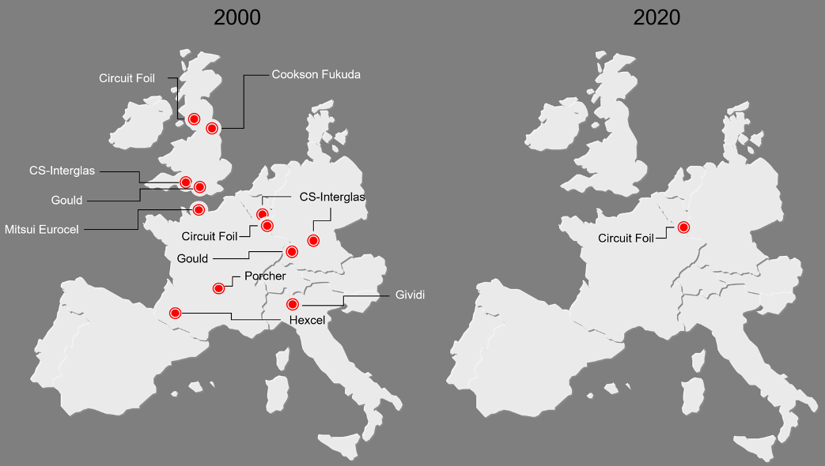
Glass & Copper foil suppliers in EU

Slide 35
What needs to be done ?
Make the electronics manufacturing industry sexy and important again
Work today on our employees for tomorrow
Create a level playing field for our industry
Invest smartly in our electronics manufacturing industry

Slide 36
Make the electronics manufacturing industry sexy and important again
Governments must communicate the importance of our industry to citizens and especially to the academic world
Governments should make our local industry a priority again when deploying public or government-subsidised funds.
Databases
Parts database
Raw materials database
E-Cad package

Slide 37
Work today on our employees for tomorrow
Promote technical studies
Offer retraining programmes
Bring our industry close to the education
Support educational institutes financially to promote electronics studies

Slide 38
Create a level playing field for our industry
Remove all import tariffs for raw materials we have need of
Encourage a homegrown raw materials industry
Look at import tariffs for finished products
Monitor the market
Energy
Motivate financial institutions to make capital available
EU origin
Lean and digital administration

Slide 39
Invest smartly in our electronics manufacturing industry
What to invest in
Education
E-CAD tool and databases
Development of electronic parts and applications
CHIP manufacturing and packaging
CHIPLET manufacturing
PCB production
PCBA production
Up to what level to invest/subsidise

Slide 40
What does it mean for you?
Study hard, you are in the right course
Many jobs available in electronics
Buy smart and support our EU industry

Slide 41
European Circular Economy
Recycled fabric
Nice movie made by the EU parliament: https://multimedia.europarl.europa.eu/en/video/v_V007-0034

Slide 42
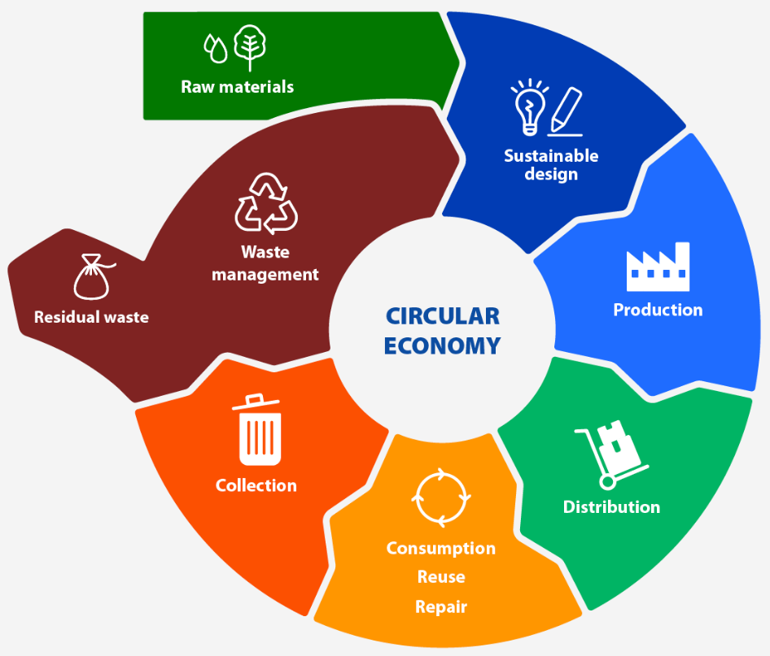

Slide 43
The EU circular economy action plan
In line with EU’s 2050 climate neutraility goal under the Green Deal, the European Commission proposed in March 2022 the first package of measures to speed up transition towards a circular economy, as announced in the Circular Economy Action Plan. The proposals include boosting sustainable products, empowering consumers for the green transition, the review of the construction product regulation, as well as a strategy on sustainable textiles.
In November 2022, the European Commission proposed new EU-wide rules on packaging. It includes proposals to improve packaging design, such as clear labelling, to promote reuse and recycling. It also calls for a transition to bio-based, biodegradable, and compostable plastics.
The Parliament called for tighter recycling rules and binding 2030 targets for materials use and consumption in a resolution adopted on 9 February 2021.
In October 2022, Parliament approved a revision of rules on persistent organic pollutants (POPs) to reduce the amount of dangerous chemicals in waste and production processes. The new rules will introduce stricter limits, ban certain chemicals and keep pollutants away from recycling.

Slide 44
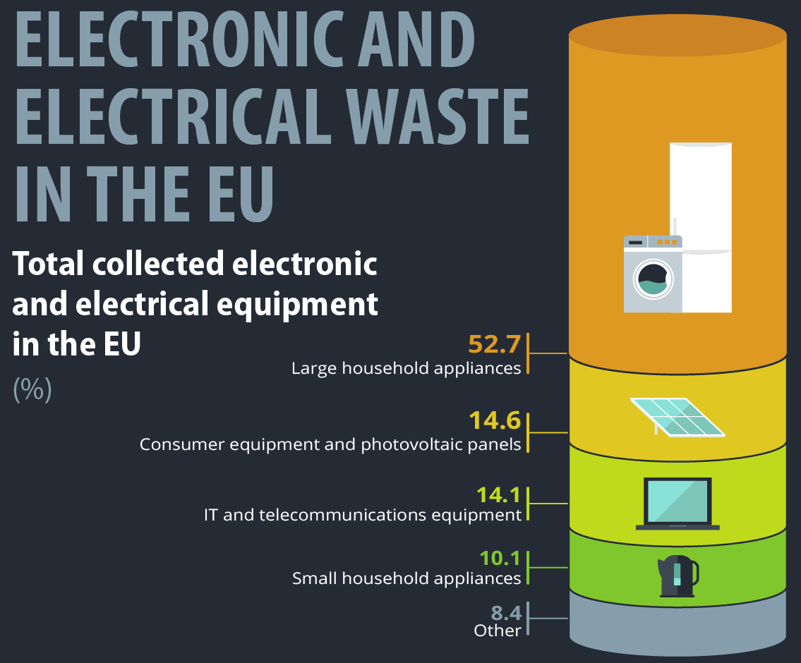

Slide 45
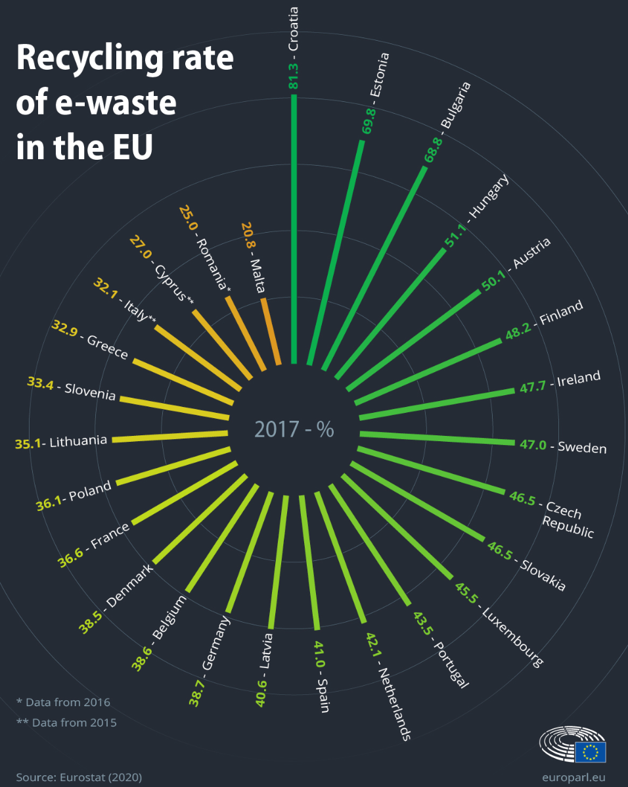
Recycling practices vary among EU countries. In 2017, Croatia recycled 81% of all electronic and electrical waste, while in Malta, the figure was 21%.
In 2020, 10.3 kilos of electrical and electronic equipment waste were collected per inhabitant in the EU.

Slide 46
What is the EU doing do reduce e-waste?
In March 2020, the European Commission presented a new circular economy action plan that has as one of its priorities the reduction of electronic and electrical waste. The proposal specifically outlined immediate goals like creating the right to repair and improving reusability in general, the introduction of a common charger and establishing a rewards system to encourage recycling electronics.
USB Type-C will become the common charger for most electronic devices in the EU by the end of 2024. Laptops will have to be equipped with a USB Type-C port by 28 April 2026.
In March 2023, the Commission presented a new proposal to promote repairing and reusing goods. Within the legal guarantee It would require sellers to repair products unless it is cheaper to replace them. Beyond the guarantee, it would provide rights to make repairs easier and cheaper.

Slide 47
What does it mean for you?
You must develop products that are:
Repairable
Recyclable
Reduce your carbon footprint as much as possible

Slide 48
Corporate Social Responsibility (CSR)
ESG (Environmental, Social and Corporate Governance)

Slide 49
What does it mean for you?
Carbon footprint indication for products
CSR reporting (audited) for large companies from 01-01-2025
CSR reporting for all from 01-01-2026

Slide 50
Eurocircuits an electronics engineer’s best friend !
Thank you !
Notes:
I hope that I could convince you all to buy local as that is the most logical and most ethical and also most economical thing to do.
I also hoped that I could convince you that Eurocircuits is an electronics engineer’s best friend.

Slide 51
HAN 2023 Buy European Dirk Stans
Notes:
BRIDGING THE GAP BETWEEN CAD & CAM
When designing an electronics application, the focus is mainly on the electronics functionality, but the PCB layout has a major impact on the manufacturability of the design. Knowledge of the manufacturing process and its capabilities is indispensable to realise good layout data. Even then, a final check of the layout by the manufacturer is a must before proceeding to production.
Eurocircuits provides its Visualizer Smart tools free of charge to check the layout, simultaneously calculate a price and perform a virtual fabrication of the layout that gives a final check and view of the data. All this helps the designer to create a "right first time for manufacture" layout, ensuring that the PCBs will be ready on time and on budget.

Slide 52
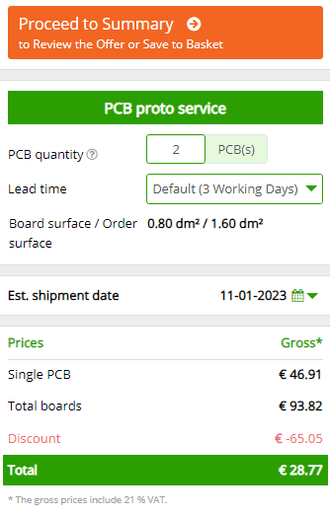
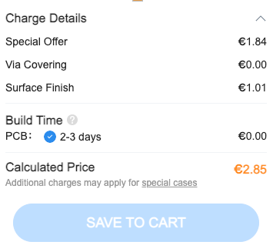
2L – 100x80mm – green - leadfree
2pcs in 3WD - Eurocircuits
5pcs in 3WD – Chinese M
Notes:
Let us compare a calculation in a Eurocircuits student account with a Chinese supplier, in this case JLCPCB.
We take a standard project of a student. 2 pieces of 2 layer boards, 100x80mm, that can be manufactured in our PCB proto service.
This means FR-4 leadfree compatible material with a leadfree finish and 150micron track and gap technology. Green soldermask and white legend and 100% electrically tested.
The Eurocircuits standard lead time for this is 3WD.
The price compares as 28,77€ incl VAT to 2,85€ excluding VAT.
That does not sound competitive. Without the huge discount of 65€ it would have been even worse.
Let’s look further.

Slide 53
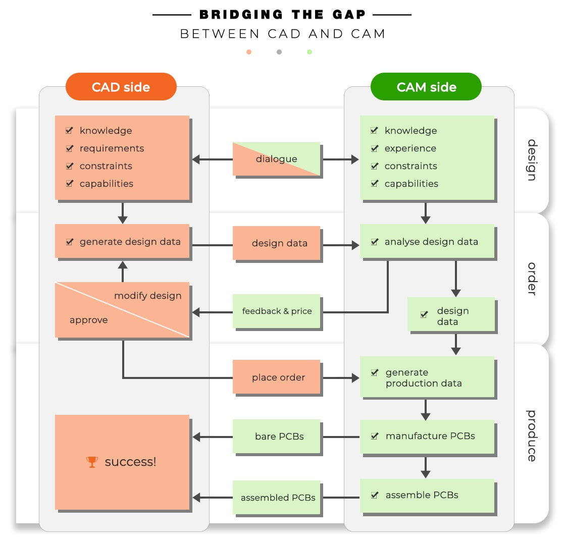
Right First Time
Design
Notes:
Right First Time avoids costly mistakes
DRC and DFM are done on PCB + Assembly before order and definitely before anything is produced.
Benefits:
validated data
Industrial quality design
lead prototypes into series to be produced at any manufacturer

Slide 54
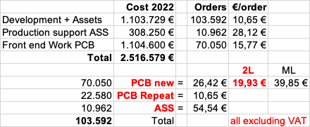
Order preparation costs - Eurocircuits
Notes:
Right First Time philosophy and giving people free access to it comes at a cost.
A cost for data preparation and data handling paid by all ordering customers.
The preparation cost for an average new 2L order come to 19,93€ excluding VAT.
Our sales price hardly covers this cost.
This is way more than the Chinese M.
Are we crazy or what? Let’s look into what’s behind this.

Slide 55
Order preparation costs - Eurocircuits
PCB Visualizer
High quality analyses (DRC and DFM)
Professional Data Feedback communication
Backed by local multi lingual customer support
High end front end tools (UCAM, Integr8tor)
Strict quality procedures and follow up
Highly trained front end, production and customer support team working for competitive wages
Notes:
Smart tools that give you reassurance that you only will check out your order once all data anomalies are dealt with.
A professional communication system to check any anomaly with the designer.
Smart tools piloted by our engineers to ensure that your PCB data only go into production when all is OK.
Professional Front End team with the worlds best Preparation Tools working according to strict quality rules.
Decently paid team members in our employment with a long state of company loyalty.
Resulting into the highest customer convenience keeping the designer customer in the driver seat and 100% informed.

Slide 56
Order preparation costs – Chinese M
Home workers are used to turn customer data in to readable and processable GC-CAM data.
??? frontend work
Q and control of Q of home workers on own hardware
Quality of GC-CAM work
=> rubish in is rubish out – minimal fault identification
??? Slaved Labour ???
Notes:
How do the Chinese do this and what it costs for them?
Home workers that invest in their own hardware and software collect ?€/job for which they transform from customer data into GC-CAM readable data.
Any further processing goes from there.
What can you do for ?€ and is this a fare price?
For sure in Europe any boss using this system at these costs would be in jail.
Do customers care?
Why 2 standards? One for the Chinese and one for us.

Slide 57
What about Base material ?
FR-4 leadfree compatible at Eurocircuits
FR-4 at Chinese M
We only use these materials for all our FR-4 pooling services
Isola IS400 - here
Nan Ya NP-155F - here
Always guarantee of:
Leadfree soldering compatibilty
TG150
CTEz of 3,5%
Td of 350°C
…
We use below Base Materials in Production(chosen at our discretion)
KINGBOARD FR-4 Materials Certifications: here
Nan Ya NP-140F Datasheet - here
Nan Ya NP-155F Datasheet - here
LONGTAI FR-4 LT140 Materials - here
Guarantees what?
Notes:
So our money is already gone in preparation and offering free use of our tools.
Let’s look at base material: FR-4 leadfree compatible is needed.
Eurocircuits only uses … and never had any material claim for any of its pooling services.
Study in cooperation with IMEC Leuven guarantees 10 solder cycles https://www.eurocircuits.com/blog/how-often-can-you-raise-a-eurocircuits-pcb-to-lead/
The Chinese supplier uses one material with the same spec as the materials EC uses, but how can you know this is used? The other materials are not up to the mark of what is needed in our leadfree society.
What is their guarantee?

Slide 58
What about Base material ?
FR-4 leadfree compatible at Eurocircuits
FR-4 at Chinese M
Sheets of 24x18” have +/- 20dm2 net area
Cost of 1 sheet bought in november 2022 = 10,62€
Our 2 x 2L boards of 100 x 80 mm use 1,6/20 x 10,62€ = 0,85€ material
Sheets of 24x18” have +/- 20dm2 net area
5 boards are made = 4dm2 = 1/5 of a panel
Cost = ? Let us guess they pay half of what we do. That would mean +/- 1€ for the job
Notes:
Let’s assume the same NanYa NP155F and that the Chinese can buy this at half our price.
In that case we have a cost of 0,85€ for the order.
They will have a cost of 1€ as they always make 5 boards.
Our money of the sales price is already consumed. The Chinese still have 1,85€ left. (Or so we are let to believe).
Let’s see what still needs to be done to make boards.

Slide 59
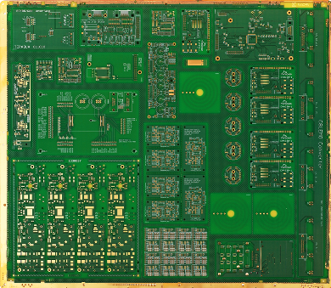
Manufacturing contains ?
Materials
Direct Labour
Manufacturing Overhead (See table to the right)
Indirect Labour + Labour charges
Depreciation
Maintenance
Transport
Subcontracting
Renting of equipment
Energy + Water
Quality insurance
1 production panel takes 40kWh of power
at an average of 280€/MWh = 11,2€/panel
Our job is 1,6dm2 out of 20dm2
The power cost for our job is 0,9€ (excl VAT)
Notes:
These manufacturing costs total to 55% of the normal sales price including front end work
This represents 50€ including VAT
Almost 1€ of this is for energy and water which probably is free at the other side of the world, no?

Slide 60
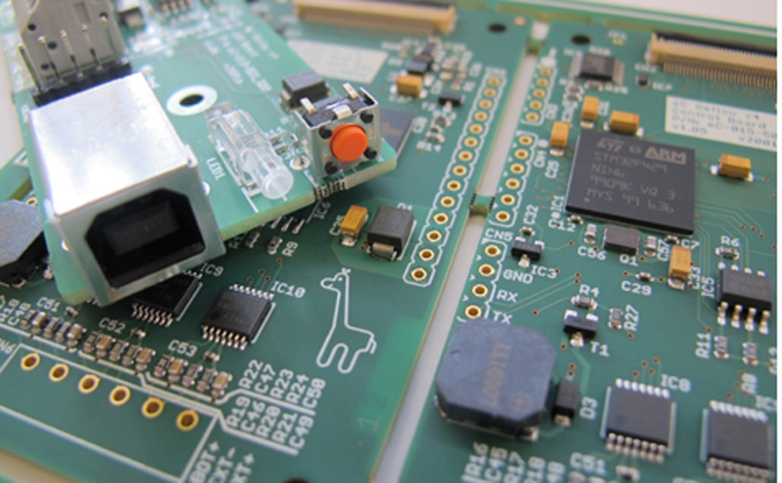
What remains ?
General overhead
Management
Investments and costs for non-manufacturing goods
Energy and other cost related to non-manufacturing subjects
Depreciations of non-manufacturing goods
Marketing & Sales
Customer Service
Financial costs
Taxes
Profit
Notes:
A company cannot exist only on operating its production.
One needs …
All of this is not for free.
Taxes are needed to build our society.
Profit is needed to be able to pay taxes and to invest and to sponsor students.

Slide 61
Corporate Social Responsibility (CSR) (ISO26000 & 14001)
Think and act: Profit – People – Planet
Eurocircuits
Green energy only (bought and installed)
Managers dedicated to every field of CSR
ISO14001 in Germany, India and almost in Eger
Brand new water treatment (+1M€)
Measuring and monitoring air polution after the filters
Carbon footprint calculation together with Fraunhofer
Social engagement (European Students and Student Teams (HAN solar boat – HAN soldering contest) – community sponsoring)
Competitive wages for our team members
Pay local taxes in Europe
Make profit to continue to invest and develop
Notes:
To thrive positively in our society for the future, we need to respect what is happening around us and the people who work for us and with whom we coexist.
Therefore, it is our duty to make a profit. We can then use this profit to make sustainable investments to:
offer more service to our customers
make work more enjoyable for our people
make our footprint on our planet as small as possible
contribute sustainably to our communities

Slide 62
2L – 100x80mm – green - leadfree
2pcs in 3WD - Eurocircuits
5pcs in 3WD – Chinese M
Frontend = 19,93€
Base material = 0,85€
= 25,14€ incl VAT
Leaving 3,63€ incl VAT to cover the costs on the previous 4 slides. Thus these costs are subsidised by us and our European professional customers
Frontend = ? €
Base material = +/- 1€ ?
Leaving 1,85€ excl VAT to cover the Frontend cost and the costs on the previous 4 slides.
=> does any one believe this is possible?
Notes:
Where were we with our costing?
It is absolutely clear that we cannot make these boards for 28,77€ including VAT.
It is clear that all our other customers and we are subsidising this, and that we do with conviction as you students are our customers of tomorrow.
Does anyone believe the Chinese can do all of this for 2,85€ excluding VAT and live up to the same standards ?
The story is not at it’s end.

Slide 63
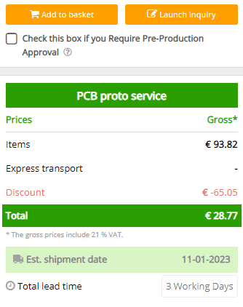
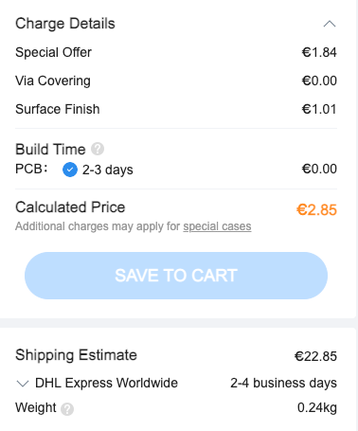
2L – 100x80mm – green - leadfree
2pcs in 3WD - Eurocircuits
5pcs in 3WD – Chinese M
Excluding VAT and import duties + costs
Notes:
Boards do not only need to be made but also delivered. (click)
In the Eurocircuits calculation, the delivery cost (Belgium in this case, but the same counts for The Netherlands) is included.
So the total price remains at 28,77€ all VAT and costs included.
Delivery is next day after the lead time of 3WD.
The standard proposed delivery cost for the Chinese is 22,85€ excluding VAT with a shipping time of 2-4 days.
That brings the total picture to …

Slide 64
2L – 100x80mm – green - leadfree
2pcs in 3WD - Eurocircuits
5pcs in 3WD – Chinese M
28,77€
Including
VAT
Transport
All costs
Shipped on working day 3, arrives next day
2,85€ boards + 22,85€ transport + 5,4€ VAT = 31,1€
Excluding
Import Duties
Import Costs
Shipped on working day 3, arrives till 4 days later
Notes:
So in the end our special student price seems better after all than the total cost of buying these boards in China.
This brings us to the following questions …

Slide 65
Why not buying European, Eurocircuits?
European customers and Eurocircuits are subsidising your student discount which makes your price competitive.
Your boards are made in an ethical European company
You have your boards faster
Right First Time saves time and money
Invest in your future to have a future.

Slide 66
Not convinced?
Why live in Europe?
Why study electronics in Europe?
Tomorrow, as an engineer, you are the most expensive factor in the design value chain
No manufacturing industry here any more, no development neither
=> Your job will be in China! Ready to move?
Notes:
Then let’s look at it from another perspective.
Why …

Slide 67
Eurocircuits an electronics engineer’s best friend !
Thank you !
Notes:
I hope that I could convince you all to buy local as that is the most logical and most ethical and also most economical thing to do.
I also hoped that I could convince you that Eurocircuits is an electronics engineer’s best friend.

Slide 68
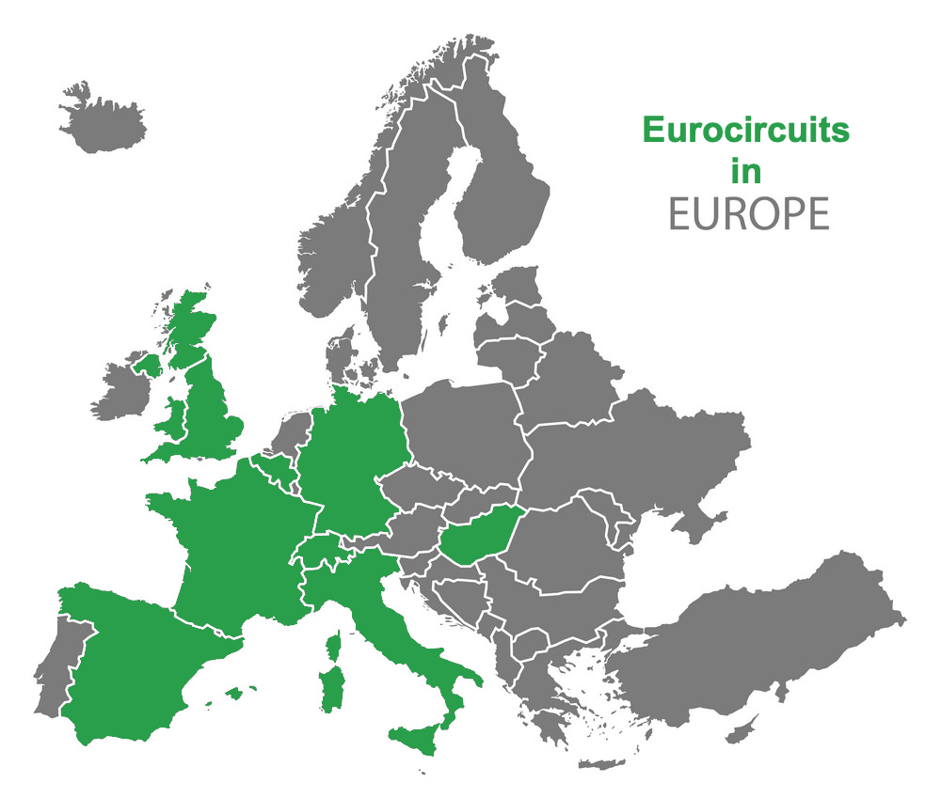
Eurocircuits Group
Headquarters: Mechelen (B)
Factories: Eger (H), Aachen (D)
Engineering/CAM: India
Local sales: Belgium, Hungary, UK, France, Germany, Switzerland, Italy, Spain
Notes:
If there are some minutes left, I would like to introduce Eurocircuits in a bit more detail.

Slide 69
PCB Manufacturing market
Technology
(Track & Gap width
and hole size)
Prototypes & small series
Volume = Series
High Density Interconnect
- T&G < 90 micron
- Laser drilled holes
Standard
Technology
T&G >= 90 micron
Mechanically drilled holes >= 100 micron
m2
Double Sided < 12,5 m2
Quick turnaround < 5WD
High flexibility
Many orders on the shop floor
Double Sided >= 12,5m2
Highly automated
Production lead times of weeks
Low flexibility
Notes:
Factories operate in any of these four market and technological quadrants and none of the factories can do all.

Slide 70
Eurocircuits philosophy
Eurocircuits - PCB cloud
Input
Design verification
Online calculation
Input
Visualization
DRC/DFM
Online pre-CAM
Output
Production preparation
Offline quotation
Customer interaction
Data preparation
Sourcing
Design
Output
Production
Libraries
eC-verified components
PCB design
E-CAD
PCB Visualizer
Bare board
Eurocircuits
Inputs
PCBA(ssembly) Visualizer = BOM editor + CPL editor
Assembly
M-CAD
3D modelling + PCBE(nclosure) Visualizer (end 2021)
Enclosure
Outputs
Front foils + PCBE(nclosure) Visualizer (end 2021)
Eurocircuits
+ Partners
Frontpanel/keypad
Printed electronics
Notes:
Eurocircuits are specialist manufacturers and assemblers of prototype & small series PCBs
We are dedicated to providing a complete electronic service that will help PCB designers bring their projects to market on time and on budget.
PCB Manufacturing – over 30 years PCB Assembly - started late 2017

